Slide 1
Technical Answers to Real Time Problems
faculty: Prof. sasikala r.

Slide 2

AUTOMATION OF USER INTERFACE FOR PHYSICALLY DISABLED

Slide 3
Team Members
16BCE0281 BELAL AHMED
16BCE0396 SUYASH GUPTA
16BCE0623 ANUP MANDHANA
16BCE0820 KRATI AGARWAL
16BCE0976 SANKALP MITTAL

Slide 4
Objective
Provide our customer better user experience.
Make the better use of technology for the Handicapped people(specially having disability with hands).
Our system is more user friendly as compared to the current technology used as it can be utilized by any age group .eg. Amazon echo
Easy gesture control by using voice control module and Artificial Intelligence Algorithms.

Slide 5
Components
MICROPHONE
GOOGLE API
BLUETOOTH MODULE
ARDUINO
USB
PYTHON IDLE

Slide 6
Component Description
MICROPHONE: Here we are using the mobile’s microphone to capture the voice and through mobile’s internal Bluetooth to Arduino connected to a Bluetooth module.
GOOGLE API: To convert the voice in signals that is transferrable through Bluetooth wirelessly.
BLUETOOTH MODULE: It is connected to Arduino module. It receives the speech signal of microphone and give it to Arduino.
ARDUINO: It processes and organise the words received and also decode and then again encode as per the requirement to transfer it to system.

Slide 7
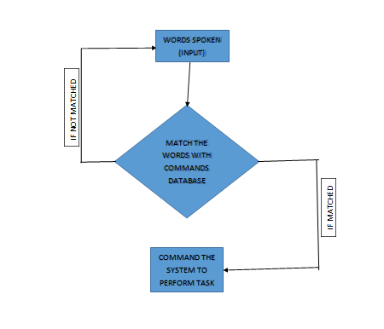
Algorithm/Flowchart

Slide 8
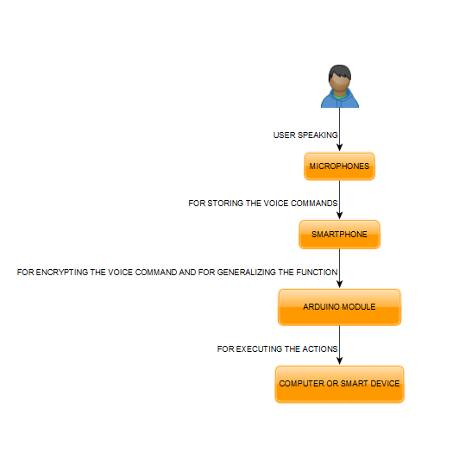
MODEL FLOW Chart

Slide 9
Experimental Setup
Various exclusive features converting speech to docs ,finding errors ,shifting the slides in the presentation by voice commands etc.
Automating the whole system using Natural Language Processing for decoding the user messages and use of Artificial Intelligence algorithm for better understanding of customer wants.
Basically Arduino is the processor to decode the statement as per the machine and transfer to the system.

Slide 10
Literature Survey Paper 1 : A Comparison of GUI and VUI Testing
While some VUI testing techniques are similar to those in GUI testing, VUI testing
presents new challenges due to the temporary nature of the voice input modality. Many of the
existing techniques for VUI testing focus on Interactive Voice Response (IVR) systems, which
are the telephone systems companies use to manage customer calls. These vary greatly from
GUI where the input modality is voice rather than the mouse/keyboard. While the input
modality is temporary, the feedback is permanent. The primary difference between GUI
and VUI testing is that GUI testing appears to be more empirical (objective)
where VUI testing appears to be more user-focused (subjective) to VUI testing would be to take
advantage of existing GUI techniques.

Slide 11
Paper 2: Swar: The Voice Operated PC
The prepared system if visualized as a block diagram will have the following components: Sound Recording and word detection component, feature extraction component, speech recognition component, acoustic and language model.
Multi-dimensional Hidden Markov Model based component used. It is the most important component of the system and is responsible for finding the best match in the knowledge base, for the incoming feature vectors

Slide 12
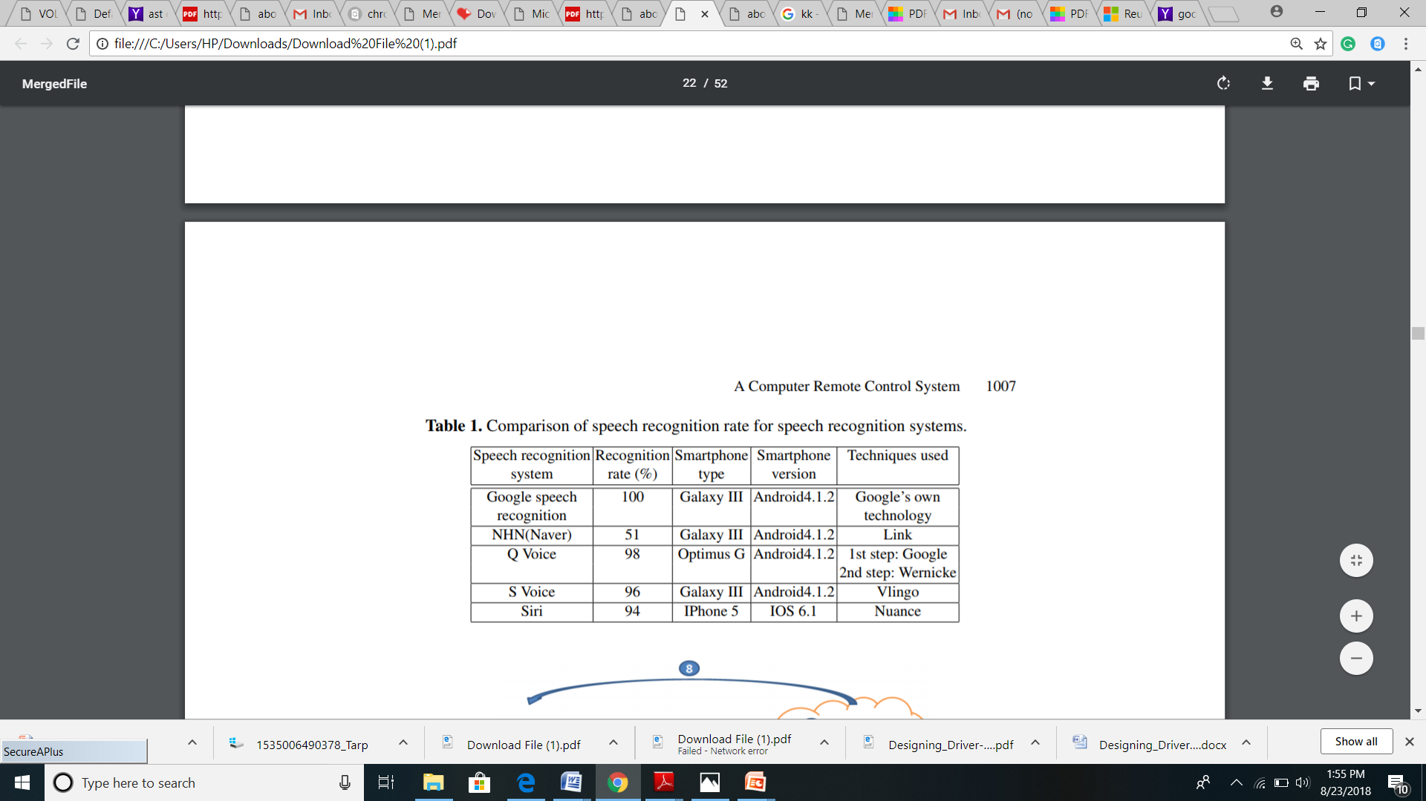
Paper 3: A Computer Remote Control System Based on Speech Recognition Technologies of Mobile Devices and Wireless Communication Technologies
Google Speech Recognition. Google uses artificial intelligence algorithms to recognize spoken sentences, stores voice data anonymously for analysis purposes, and cross matches spoken data with written queries on the server.

Slide 13
Paper 4: Designing Driver-centric Natural Voice User Interfaces
This paper explored the use of Natural Voice User Interfaces (NVUI) in driving scenarios, analyze its risks and benefits and aims to propose design guidelines for driver-centric applications based on previous research experience.
NVUI APPLICATION IN AUTOMOTIVE ENVIRONMENTS : A natural voice user interface (NVUI) is one in which a person can speak to a computer system as they would when conversing with another human being. NVUIs are agent based systems that understand what the user says and respond to it ; therefore, allowing users to interact in a natural way eliminating the need for remembering a specific lists of commands.
Human speech refers to speech segments that are prerecorded by a human while synthesized speech is an artificial production of speech via a computer, and is often produced via text-to speech (TTS) engines. Utilizing natural speech, in comparison with synthetic speech, in applications that deliver high amounts of prerecorded speech segments is found to be difficult and rather costly

Slide 14
Paper 5:The Design of User Interfaces for Digital Speech Recognition Software
DSRS is a command and control application integrated with the UNIX desktop environment. It accepts user commands spoken into a microphone and converts them into keystrokes.
DSRS comprises several major components. Of these components, three are licensed from Dragon Systems, Inc.: the front-end processor, the recognizer engine, and the speaker-independent speech models. Data acquisition consists of the microphone, audio card, and the multimedia services application programming interface (API) that provides support for the sound card. The front-end processor analyzes a stream of digitized data and differentiates between silence, noise, and speech; it then extracts a set of computed features from the speech signals.
Speech recognition is an evolutionary step in the overall computer–user interface. It is not a replacement for the keyboard and mouse and should be used to complement these devices

Slide 15
Our CONTRIBUTION
REVOLUTION for Handicapped people to help them fully AUTOMATE their PERSONAL computers.
Our PROJECT is different from existing work, as we are using ARDUINO which is extremely CHEAP.
We are NOT using ASP.NET, hence our project is not limited to WINDOWS platforms only.
LOW POWER
EXTREMELY USER Friendly, easy to use for people from all ages.
LESS hardware set up.

Slide 16
User Characteristics Needed to operate the product
The user of the automation system designed is expected to be:
Familiar with basic commands that will be used in the voice command application. For example OPEN for opening an application or file, NEXT for going one page up in a text file or moving on to the next slide in a slide show.
Able to provide voice commands in a clear and legible manner to the system
Familiar with basic operations that can be performed on a file or application
Requiring special handling of power point presentations

Slide 17
Project TIME LINE
At First we will do the survey to get the input from the users regarding the automation of the computer system. In this we get the words which people will commonly use to perform a certain task
01
Secondly we will complete the software part of this project which involves the coding in python. We will take the voice command and analyze the words and based on that conditionally it will perform the required task.
02
And at Last we will connect the hardware connection which will capture the voice and will transmit it to the computer system.

Slide 18
WHY our PRODUCT?
Efficiency
The product is efficient enough to produce a specific outcome with a minimum amount or quantity of waste, expense, or unnecessary effort.
Reliability
The ability of a product to perform its required functions under stated conditions for a specified time.
Portability
software can be run (with little or no modification) on different hardware and/or software platforms, and works with different versions of the same hardware or program.
Usability
Our software can be used by specified consumers to achieve quantified objectives with effectiveness, efficiency, and satisfaction in a quantified context of use.

Slide 19
Thank You

